Slide 1



Chapter 5 Link Layer
Computer Networking: A Top Down Approach 6th edition Jim Kurose, Keith Ross Addison-Wesley March 2012
A note on the use of these ppt slides:
We’re making these slides freely available to all (faculty, students, readers). They’re in PowerPoint form so you see the animations; and can add, modify, and delete slides (including this one) and slide content to suit your needs. They obviously represent a lot of work on our part. In return for use, we only ask the following:
If you use these slides (e.g., in a class) that you mention their source (after all, we’d like people to use our book!)
If you post any slides on a www site, that you note that they are adapted from (or perhaps identical to) our slides, and note our copyright of this material.
Thanks and enjoy! JFK/KWR
All material copyright 1996-2012
J.F Kurose and K.W. Ross, All Rights Reserved

Slide 2
Link layer, LANs: outline
5.1 introduction, services
5.2 error detection, correction
5.3 multiple access protocols
5.4 LANs
addressing, ARP
Ethernet
switches
VLANS
5.5 link virtualization: MPLS
5.6 data center networking
5.7 a day in the life of a web request

Slide 3

MAC addresses and ARP
32-bit IP address:
network-layer address for interface
used for layer 3 (network layer) forwarding
MAC (or LAN or physical or Ethernet) address:
function: used ‘locally” to get frame from one interface to another physically-connected interface (same network, in IP-addressing sense)
48 bit MAC address (for most LANs) burned in NIC ROM, also sometimes software settable
e.g.: 1A-2F-BB-76-09-AD
hexadecimal (base 16) notation
(each “number” represents 4 bits)

Slide 4


LAN addresses and ARP
each adapter on LAN has unique LAN address
1A-2F-BB-76-09-AD
LAN
(wired or
wireless)
adapter
71-65-F7-2B-08-53
58-23-D7-FA-20-B0
0C-C4-11-6F-E3-98

Slide 5
LAN addresses (more)
MAC address allocation administered by IEEE
manufacturer buys portion of MAC address space (to assure uniqueness)
analogy:
MAC address: like Social Security Number
IP address: like postal address
MAC flat address ➜ portability
can move LAN card from one LAN to another
IP hierarchical address not portable
address depends on IP subnet to which node is attached

Slide 6


ARP: address resolution protocol
Question: how to determine
interface’s MAC address, knowing its IP address?
ARP table: each IP node (host, router) on LAN has table
IP/MAC address mappings for some LAN nodes:
< IP address; MAC address; TTL>
TTL (Time To Live): time after which address mapping will be forgotten (typically 20 min)
137.196.7.78
1A-2F-BB-76-09-AD
137.196.7.23
137.196.7.14
LAN
71-65-F7-2B-08-53
58-23-D7-FA-20-B0
0C-C4-11-6F-E3-98
137.196.7.88

Slide 7

ARP protocol: same LAN
A wants to send datagram to B
B’s MAC address not in A’s ARP table.
A broadcasts ARP query packet, containing B's IP address
dest MAC address = FF-FF-FF-FF-FF-FF
all nodes on LAN receive ARP query
B receives ARP packet, replies to A with its (B's) MAC address
frame sent to A’s MAC address (unicast)
A caches (saves) IP-to-MAC address pair in its ARP table until information becomes old (times out)
soft state: information that times out (goes away) unless refreshed
ARP is “plug-and-play”:
nodes create their ARP tables without intervention from net administrator

Slide 8
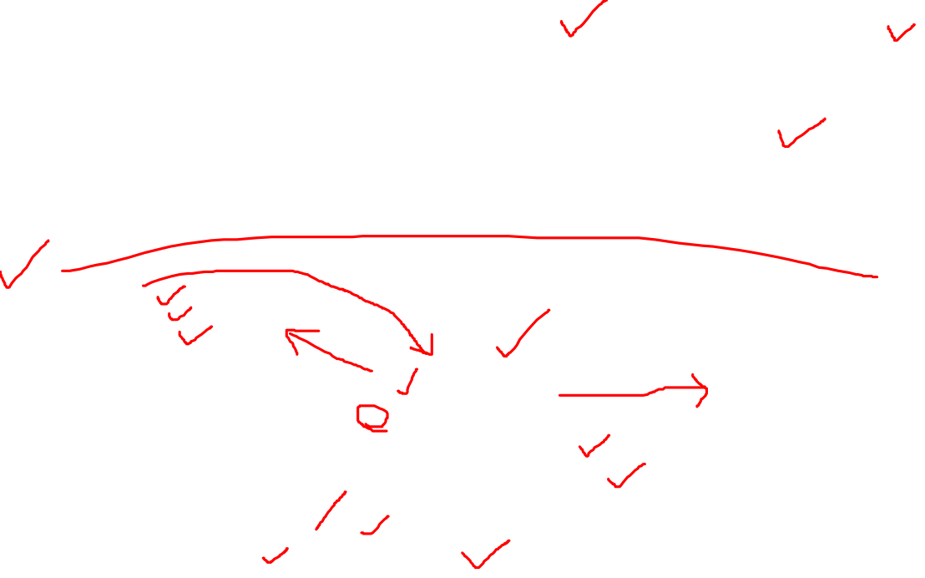
Addressing: routing to another LAN
walkthrough: send datagram from A to B via R
focus on addressing – at IP (datagram) and MAC layer (frame)
assume A knows B’s IP address
assume A knows IP address of first hop router, R (how?)
assume A knows R’s MAC address (how?)
A
B
R
111.111.111.111
222.222.222.222
74-29-9C-E8-FF-55
49-BD-D2-C7-56-2A
222.222.222.220
1A-23-F9-CD-06-9B
111.111.111.112
111.111.111.110
222.222.222.221
CC-49-DE-D0-AB-7D
E6-E9-00-17-BB-4B
88-B2-2F-54-1A-0F

Slide 9

Addressing: routing to another LAN
A creates IP datagram with IP source A, destination B
A creates link-layer frame with R's MAC address as dest, frame contains A-to-B IP datagram
MAC src: 74-29-9C-E8-FF-55
MAC dest: E6-E9-00-17-BB-4B
IP
Eth
Phy
IP src: 111.111.111.111
IP dest: 222.222.222.222
A
B
R
111.111.111.111
222.222.222.222
74-29-9C-E8-FF-55
49-BD-D2-C7-56-2A
222.222.222.220
1A-23-F9-CD-06-9B
111.111.111.112
111.111.111.110
222.222.222.221
CC-49-DE-D0-AB-7D
E6-E9-00-17-BB-4B
88-B2-2F-54-1A-0F

Slide 10

Addressing: routing to another LAN
frame sent from A to R
frame received at R, datagram removed, passed up to IP
MAC src: 74-29-9C-E8-FF-55
MAC dest: E6-E9-00-17-BB-4B
IP src: 111.111.111.111
IP dest: 222.222.222.222
IP
Eth
Phy
IP src: 111.111.111.111
IP dest: 222.222.222.222
IP
Eth
Phy
A
B
R
111.111.111.111
222.222.222.222
74-29-9C-E8-FF-55
49-BD-D2-C7-56-2A
222.222.222.220
1A-23-F9-CD-06-9B
111.111.111.112
111.111.111.110
222.222.222.221
CC-49-DE-D0-AB-7D
E6-E9-00-17-BB-4B
88-B2-2F-54-1A-0F

Slide 11

Addressing: routing to another LAN
R forwards datagram with IP source A, destination B
R creates link-layer frame with B's MAC address as dest, frame contains A-to-B IP datagram
MAC src: 1A-23-F9-CD-06-9B
MAC dest: 49-BD-D2-C7-56-2A
IP
Eth
Phy
IP
Eth
Phy
IP src: 111.111.111.111
IP dest: 222.222.222.222
A
B
R
111.111.111.111
222.222.222.222
74-29-9C-E8-FF-55
49-BD-D2-C7-56-2A
222.222.222.220
1A-23-F9-CD-06-9B
111.111.111.112
111.111.111.110
222.222.222.221
CC-49-DE-D0-AB-7D
E6-E9-00-17-BB-4B
88-B2-2F-54-1A-0F

Slide 12
Addressing: routing to another LAN
R forwards datagram with IP source A, destination B
R creates link-layer frame with B's MAC address as dest, frame contains A-to-B IP datagram
MAC src: 1A-23-F9-CD-06-9B
MAC dest: 49-BD-D2-C7-56-2A
IP
Eth
Phy
IP
Eth
Phy
IP src: 111.111.111.111
IP dest: 222.222.222.222
A
B
R
111.111.111.111
222.222.222.222
74-29-9C-E8-FF-55
49-BD-D2-C7-56-2A
222.222.222.220
1A-23-F9-CD-06-9B
111.111.111.112
111.111.111.110
222.222.222.221
CC-49-DE-D0-AB-7D
E6-E9-00-17-BB-4B
88-B2-2F-54-1A-0F

Slide 13
Addressing: routing to another LAN
R forwards datagram with IP source A, destination B
R creates link-layer frame with B's MAC address as dest, frame contains A-to-B IP datagram
MAC src: 1A-23-F9-CD-06-9B
MAC dest: 49-BD-D2-C7-56-2A
IP src: 111.111.111.111
IP dest: 222.222.222.222
IP
Eth
Phy
A
B
R
111.111.111.111
222.222.222.222
74-29-9C-E8-FF-55
49-BD-D2-C7-56-2A
222.222.222.220
1A-23-F9-CD-06-9B
111.111.111.112
111.111.111.110
222.222.222.221
CC-49-DE-D0-AB-7D
E6-E9-00-17-BB-4B
88-B2-2F-54-1A-0F

